Slide 1
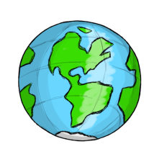
Year 6 Geography Task
Where in the world would you like to travel?
Study a world map and plan a route around the world, include at least 6 locations
Design a Postcard to document your journey and make comparisons to what life is like in your home town.
Label the City of choice in each location, the Country and Continent and Oceans onto your world map
Write a log of your journey. State each leg of your route, the method of transport, km/miles travelled and longitude and latitude across the world.
Research using the internet. books, guide books, maps, documentaries and personal experiences each location and create a fact file for each stop
Pack your suitcase – Design a collage with all of the items and clothing that you will need for your journey,

